Slide 1
Building LXI-Based Test Systems
LAN eXtentions for Instrumentation
LXI Consortium Presentation
May 14, 2017
Notes:
Welcome to this series of presentations on LXI. If you are new to LXI, you should watch Connecting with LXI first. It will cover some key aspects of any LXI Device.
The focus of this presentation will be on connecting multiple LXI Devices together to build an LXI-based Test System.

Slide 2
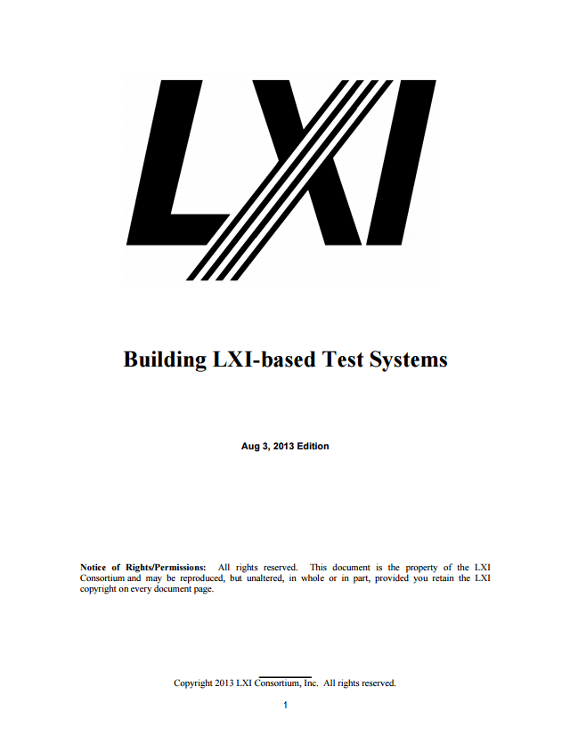
Building LXI-Based Test Systems
LAN eXtentions for Instrumentation
LXI Consortium Presentation
May 14, 2017
Notes:
Key points of this presentation were taking from the LXI Consortium document Building LXI-Based Test Systems. That document can be found on the LXI Consortium web site and provides much more detailed information about recommended LAN configurations, communicating with LXI devices, security, and best practices.

Slide 3
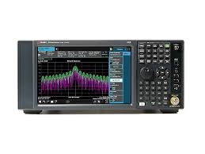
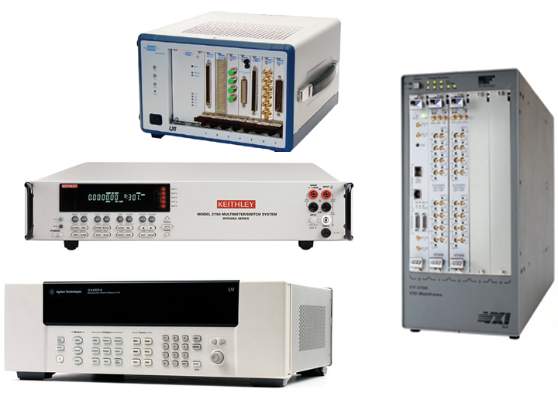
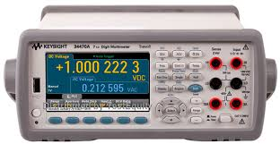
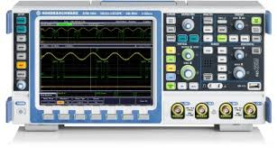
LXI Products and Productivity
Over 3600 Instruments are LXI Conformant
All LXI Devices connect the same over LAN
All LXI Devices have IVI Driver for quick programming
Most LXI Devices have Web Monitoring/Control
LXI boxes, LXI to PXI, and LXI to VXI choices
…building a Test System hardly gets better!
Notes:
Established in 2004…over 55 of the top T&M companies sponsored and developed this technology, and there are more than 3600 products in over 50 different product families. LXI (LAN eXtensions for Instrumentation) is the current and future standard for Test and Measurement Systems.
Prior to this standard there were LAN-based instruments, but there were as many different ways of configuring these devices as there were products. With the LXI Standard, all devices behave the same when connecting to LAN, they all come with easy to use IVI Drivers, example programming, and most have added Web Pages for monitoring and controlling functionality.
LAN Connectivity is common, fast, inexpensive, and reliable…all features you want in a test system.

Slide 4
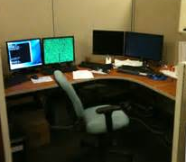
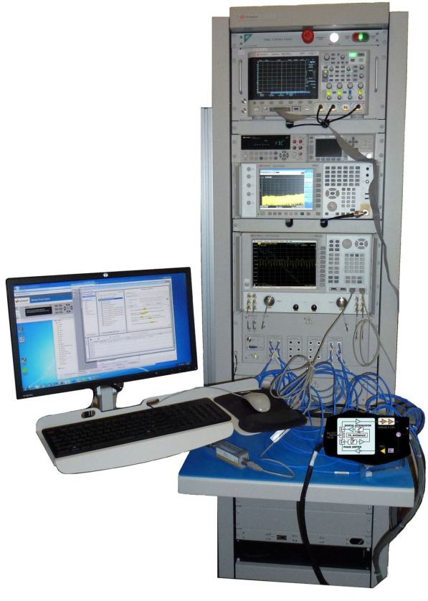
LXI expands Test System access
You want to work here…
14000 km
60 meters
…but your Test Systems are way over there
…and in a noisy environment.
Notes:
For a test system engineer, it is usually inconvenient and uncomfortable to work next to the test system. You want the comfort of a quiet office environment to develop your test programs, and you may be supporting a test system not even in your facility.

Slide 5
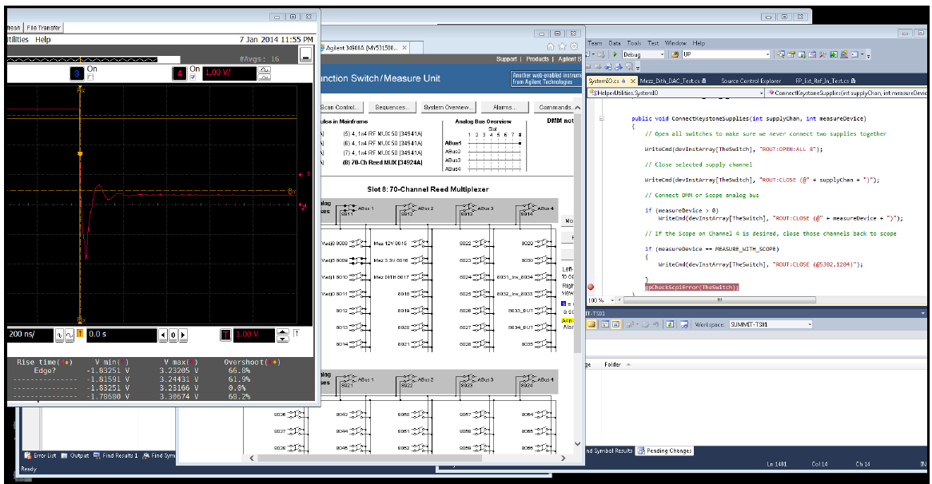
Fast development/troubleshooting with LXI
You can Remote Login to the Test System PC
LXI Devices on test system share a private LAN with PC
IVI Drivers provide quick access to LXI Device functionality
You can monitor/debug your code via Web Pages
Test
Program
Web Page
Scope
Web Page
Switching
Notes:
With a Test System full of various signal generation, measurement, and switching products, you need a way to see what is going on…
It is a common solution to Remote Login to your test system…nothing special about that. But, with LXI Devices, that remote connection then provides Web Page access to the various measurement and control devices. For example, a test is failing, so you step through the test program looking at the result on the Scope Web page. Hmmm…not right…so, you check the switch path using the Switch Web Page. Ah…wrong combination of switches…problem solved! And, you did it from the comfort of your desk.

Slide 6
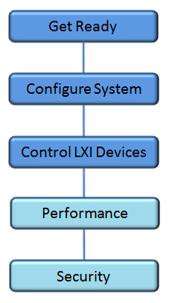
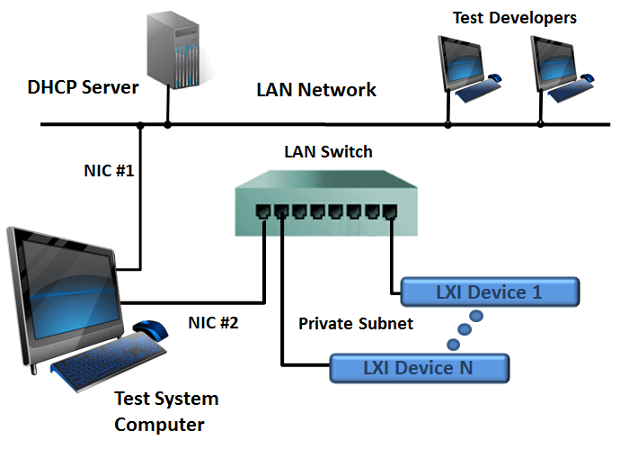
A system consists of multiple LXI Devices…
…here is one possible configuration. Are there others?
Notes:
In the presentation Getting Started with LXI, you learned how to connect a single instrument to your LAN, discover it, and control it. Building an entire system requires additional considerations we will discuss in this presentation.
Performance and Security are two very important topics in deploying your new test system. These are so important, we created two additional presentations just to cover those topics.
For now, let’s keep our focus on assembling the hardware and software that connects everything together, allows programming, and gives you the luxury of monitoring your devices with the LXI Web Pages.

Slide 7
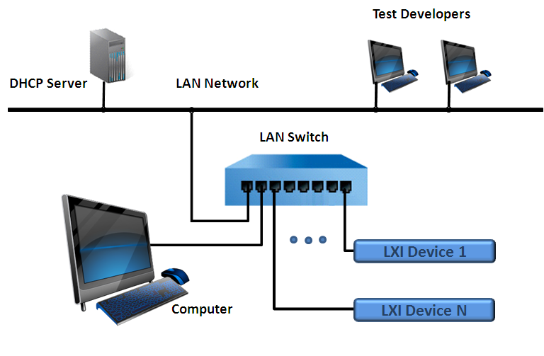
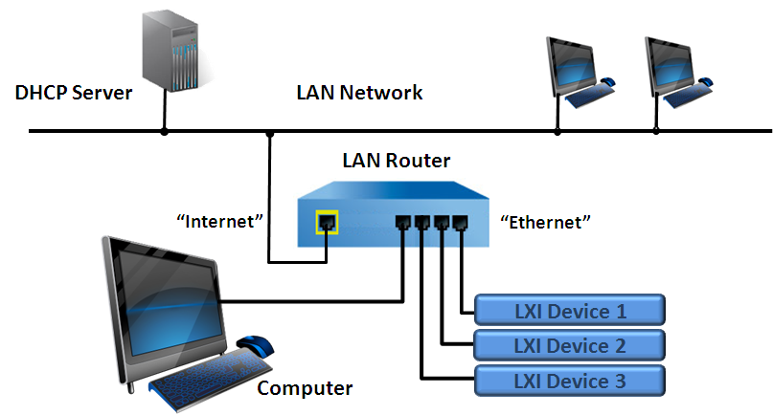
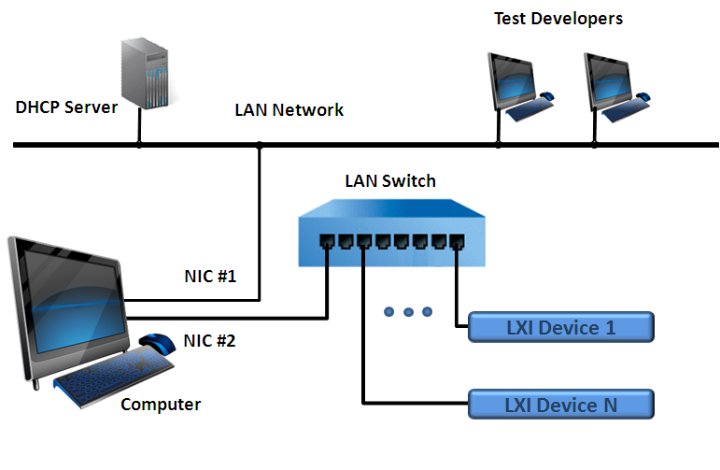
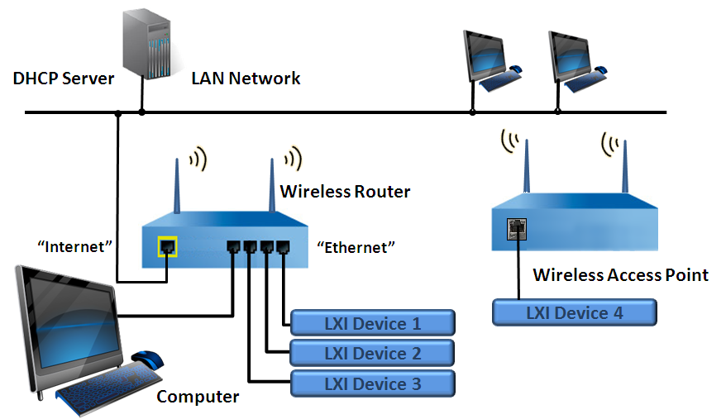
Multiple configurations to choose
A
B
C
D
…we’ll pick C… a recommended configuration
Notes:
Here are four configurations discussed in the Building LXI-Based Test System document found on the LXI Consortium Web Site. That document discusses various criteria for choosing one configuration over another.
Briefly:
A – All of your test instruments and your test computer are on the same LAN as everyone else in your company. Great for sharing, but potential outside interference with tests is unavoidable
B – Your test system computer is isolated from company LAN by a router. Avoids interference but becomes more difficult for others to log into the test computer
D – Is essentially the same as B, except the router is also Wireless, so you can place one or more instruments in locations difficult to connect with LAN cables
C – This is probably the most recommended configuration, since it offers easy access to the test computer, but the instruments are isolated from the company LAN
This presentation will focus on C, and you will learn some of its key features and benefits.

Slide 8
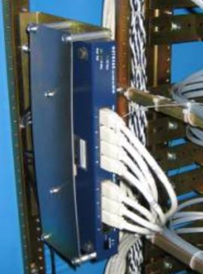
Get Ready – What do you need?
What you need
Computer with two LAN Ports
LAN Switch with 8-16 ports
LAN cables
Your LXI Devices
VISA I/O Library
LXI Discovery Tool
Notes:
For Configuration C, you need a computer with two LAN ports. One will connect to the company LAN, and the other creates a private subnet for all of the LXI Devices.
A LAN switch provides the connection to each LXI Device, and the LAN cables can be neatly routed within your rack.
Although you don’t need any special software to bring up the LXI Device’s Web Pages, you need the VISA IO Library IVI Drivers if you want to program the LXI Devices. Companies like National Instruments and Keysight provide comprehensive solutions for the VISA IO Library. Each LXI Device is required to provide an IVI Driver, which is obtained from the particular company website. The ivifoundation.org website provides a listing of all IVI Drivers with pointers to each company’s website for download.

Slide 9
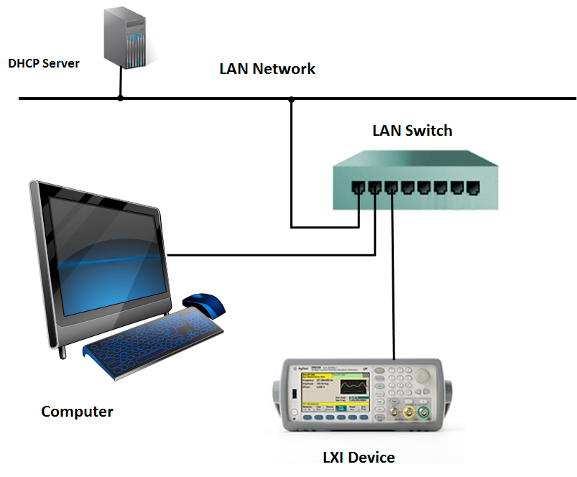
This is simple…
What happens?
Computer and LXI Device ask DHCP Server for IP address
That DHCP Server provides a wonderful connection experience
…but, there are challenges for a Test System
Notes:
This configuration was covered in the LXI Getting Started presentation. It is simple. You plug the device into the company’s LAN, and the DHCP server gives it an IP address. Unfortunately, that IP address could be anything. You can discover it with tools from the VISA IO Library or using the LXI Discovery Tool. However, when connected to the company’s LAN, those tools will also discover every other LXI Device.

Slide 10
Configuration C is a bit harder…
What happens?
Computer NIC #1 gets its IP address from DHCP
Instruments on NIC #2 fall into an Auto IP configuration
169.254.x.x
…Auto IP takes longer and IP addresses are indeterminate
…but this gets us almost to the configuration we want
Notes:
Getting back to Configuration C, we have isolated the LXI Devices from the company LAN. We have also isolated ourselves from the DHCP Server…which automatically assigned IP addresses. However, the LXI specification requires that devices connected as seen above will drop into AutoIP when no DHCP Server is discovered. AutoIP also assigns somewhat arbitrary IP addresses in the 169.254.x.x range. For this configuration, most Test Engineers would want to assign fixed IP addresses to each LXI Device. How do we do that?

Slide 11
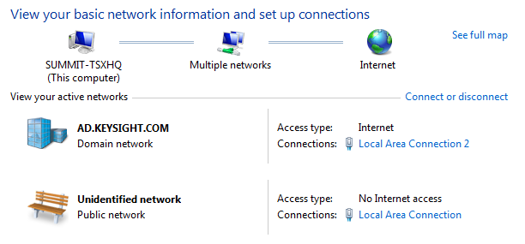
First - Reconfigure NIC #2…
NIC #1
NIC #2
Notes:
The NIC #2 LAN interface likewise dropped into the AutoIP range of addresses. It too should be assigned a static IP address.
TBD text when the image is captured.

Slide 12
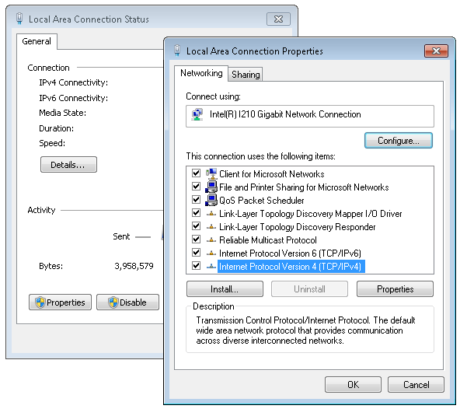
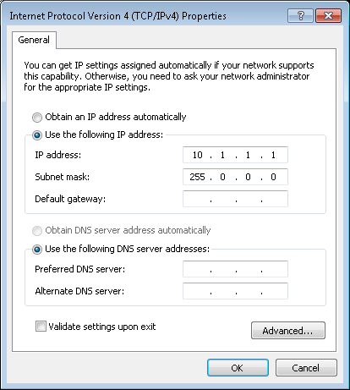
First - Reconfigure NIC #2…
Notes:
We want to assign a private subnet address range using a static IP on NIC #2. The range 10.x.x.x is commonly used for static IP.

Slide 13
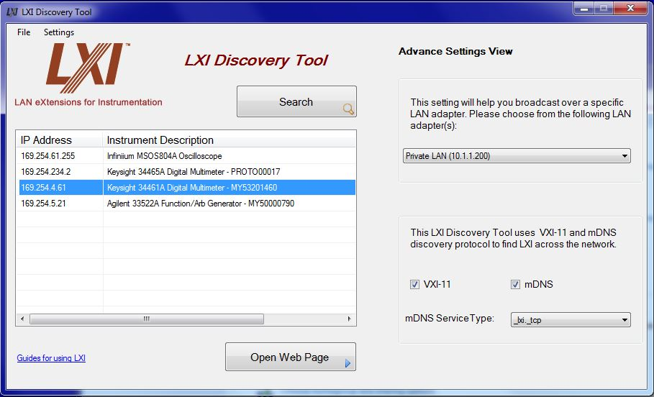
LXI Discovery…
www.lxistandard.org
Notes:
The LXI Discovery Tool can be used to only search for LXI Devices on the private subnet – NIC #2, using the Advanced Menu. Once all LXI Devices are found, you can bring up each LXI Device’s Welcome Page

Slide 14
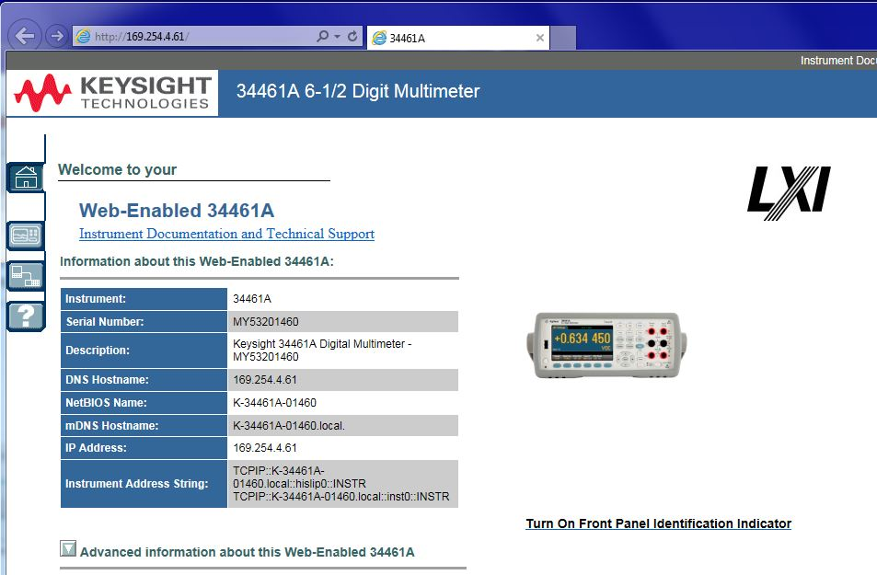
Reconfigure LXI Device IP…
LXI Welcome Page
Monitor/Control
LAN Configure
Identify
VISA String
Notes:
If you have multiple LXI Devices that are all the same model number, you can press the ID button, and an indicator will flash on that device, either on the screen or a blinking LED.
There will be some sort of indication, labeled or icon, that indication LAN Configuration. That is where we need to go to change the IP address.

Slide 15
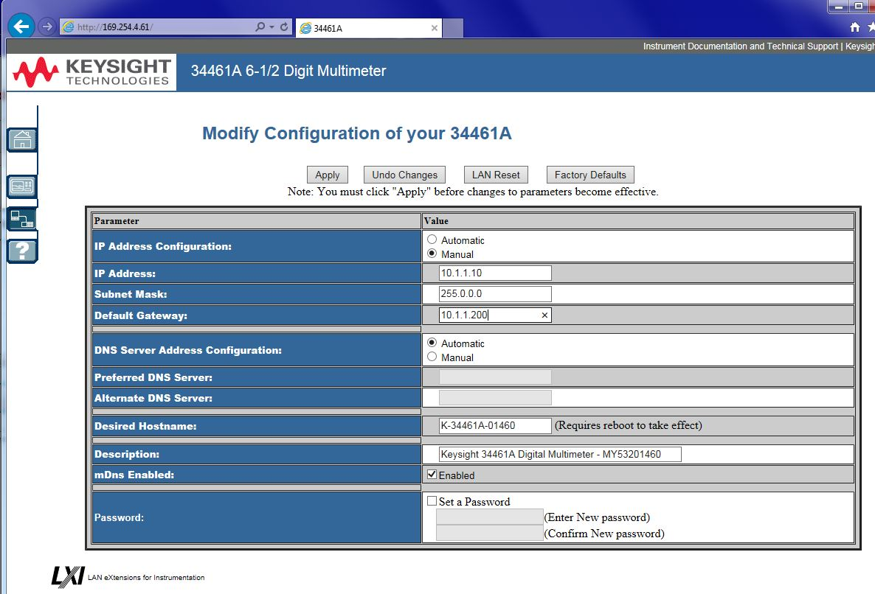
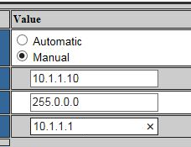
Reconfigure LXI Device IP…
LXI LAN Configuration Page
Static IP
Device IP
NIC #2 IP
Notes:
The LXI Device will be shipped configured for Automatic or DHCP. To make the device’s address static, you choose Manual. Note the gateway is NIC #2’s IP address.

Slide 16
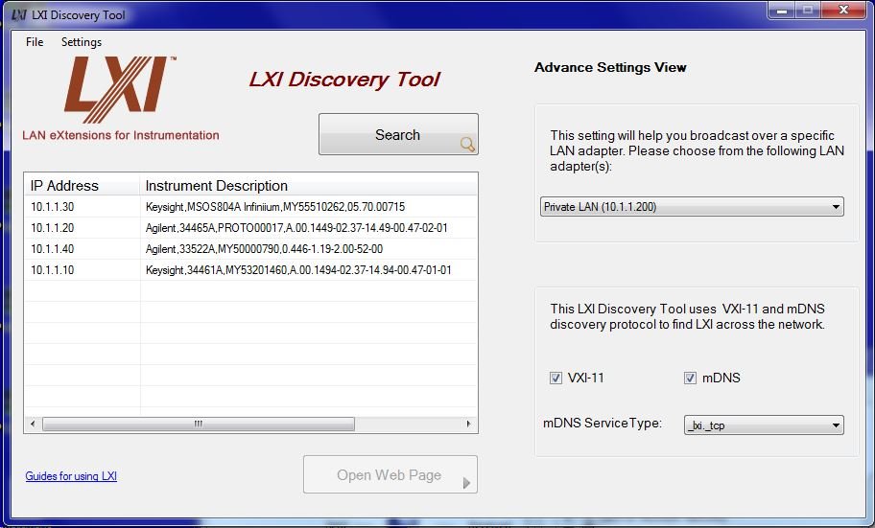
LXI Discovery…
Notes:
You repeat the previous operation for each LXI Device, and the final result is all of the LXI Devices are on the same subnet as NIC #2.

Slide 17
VISA IO Library and IVI Drivers
Install VISA IO Library
Keysight Technologies : www.keysight.com
National Instruments : www.ni.com
Install IVI Drivers
IVI Foundation has pointers to all conformant drivers: www.ivifoundation.org
IVI Drivers come with Examples in multiple languages
IVI-C, IVI-COM, and IVI.NET
Notes:
Now it’s time to install the really software – the means to which you can develop and control these instruments.
Two of the top choices for the I/O Library called VISA are Keysight and National Instruments. Those companies also include discovery tools for discovering LAN, USB, and GPIB interfaces.
Since every LXI Device is required to supply an IVI Driver, you have an easy means to programming your systems instruments quickly. IVI Drivers are all registered on the IVI Foundation website, so if you are putting together a system, you can find pointers to the driver software at the various vendors supplying your test equipment.
The IVI Foundation maintains the standards for both VISA and IVI.

Slide 18
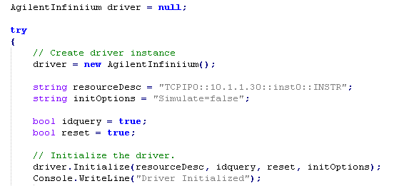
Control LXI Devices
VISA Connection String

Slide 19
Next Steps – Guides/Videos for Using LXI
LXI Getting Started
Building LXI-Based Test Systems
Introducing LXI To Your Network Administrator
Maximizing Performance of LXI-Based Test System
Test Systems Using LXI
LXI Networking Basics
http://www.lxistandard.org/About/Guides-for-using-LXI.aspx
Notes:
You have learned a lot more about connecting multiple LXI Devices into an LXI-Based Test System. You can learn much more detail accessing some of the same-named documents on the LXI Consortium website. Also, there are two other presentations that cover Network Security and Performance.
Thank you for your time.

